Slide 1
Communicating with Data – Introduction to Interactive Visualization
Dr. Ab Mosca (they/them)
Slides based off slides courtesy of Jordan Crouser (https://jcrouser.github.io/)

Slide 2
Mid Semester Project
Visual Encoding Leads:
What is our final visual encoding?
What materials do we need to acquire?
Visualization Creation Leads:
Decide how we will divide labor for creating the visualization and other necessary materials (ex. Title, Instructions, etc.)
What needs to be accomplished? How will you split it between class members?)
Final proofread of materials (ex. Do instructions make sense?)

Slide 3
Plan for Today
Interaction
Definition
Data and problem spaces
Relationship between interaction and understanding
Interaction with visual interfaces
Basic interaction types
Demo: coordinated multiple views

Slide 4


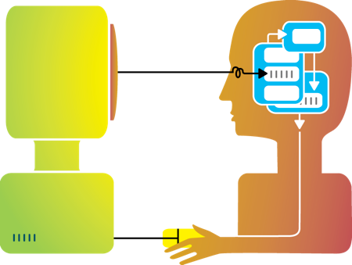
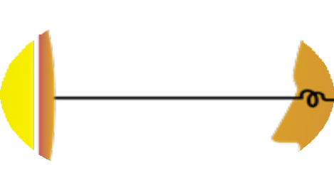
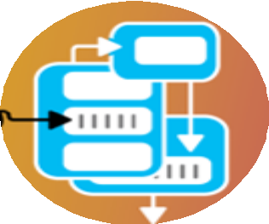




Rewind
Humans and machines have complimentary strengths
Visualization
Perception
and context
Interaction
Computational power
Image credit: Ali Ansari

Slide 5
Interaction (def.)
“Interaction for visualization is the interplay between a person and a data interface involving a data-related intent, at least one action from the person and an interface reaction that is perceived as such.”
Mandatory Components
Interplay
Person
Data Interface
Action
Action-Reaction
Reaction Perceived as Such
Data-Related Intent
What is Interaction for Data Visualization? Evanthia Dimara, Charles Perin. 2020
Notes:
Interplay – “dialogue”
Person -
Data Interface– the vis
Action – Any action, physical or mental, regardless of modality that causes the reaction of the data interface
Action-Reaction– cause effect between entities
Reaction Perceived as Such – person must perceive the reaction in the data interface
Data-Related Intent – intent is tied to a data source and is formed iteratively throughout the interaction cycle

Slide 6
High level: between human and problem space
a cognitive act enabled by the tool
does not need to take place exclusively within them
might be distributed across multiple tools
Low level: between human and interface
the set of operations available
the relationship between the human and the visualization
Interaction

Slide 7
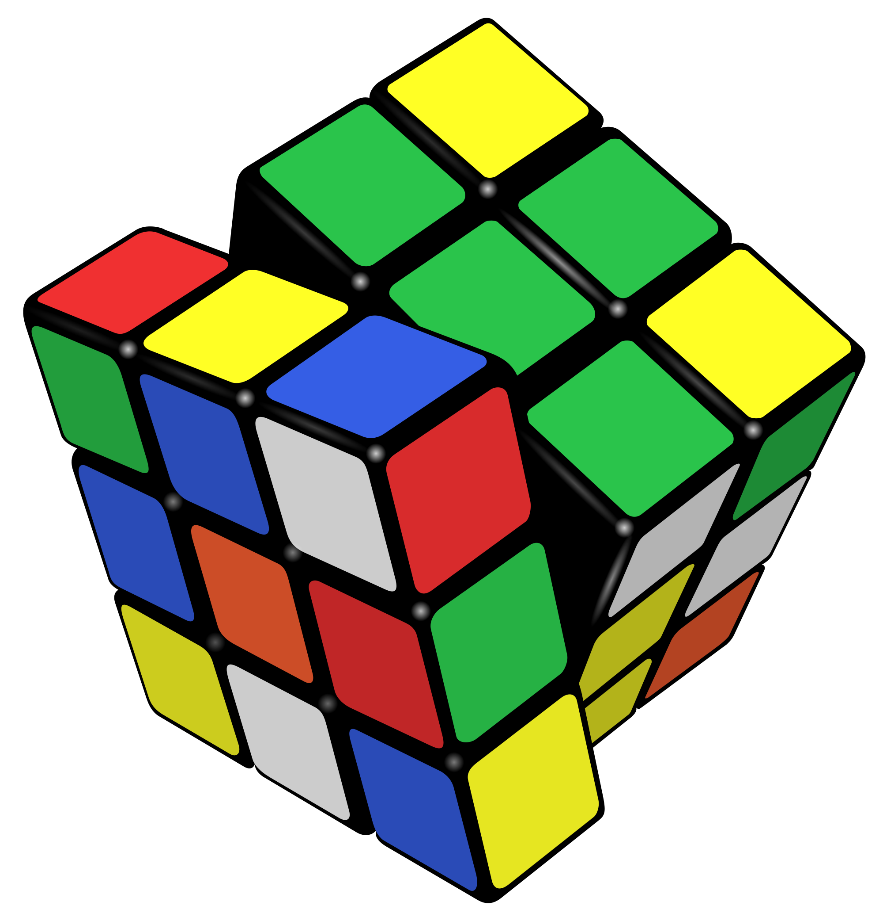
Example: Rubik’s Cube
What high-level interactions are there?
What low-level interactions could there be?

Slide 8



Example: Vitals
What high-level interactions are there?
What low-level interactions could there be?

Slide 9

Example: Lumos
https://lumos-webapp-4aeadb3bf30d.herokuapp.com/
What were your high-level interactions?
What were your low-level interactions?
Notes:
Explore & find something interesting

Slide 10
Part I: High Level
Interaction with
Data / Problem Space

Slide 11
High-level interactions with a visualization correspond to analysis tasks
We can think about why users perform interactions at different levels of specificity
Brehmer and Munzner (2013)
M. Brehmer and T. Munzner, "A Multi-Level Typology of Abstract Visualization Tasks," in IEEE Transactions on Visualization and Computer Graphics, vol. 19, no. 12, pp. 2376-2385, Dec. 2013, doi: 10.1109/TVCG.2013.124.

Slide 12
Learn
Read a data story; be guided through a series of cognitive operations
Discover
Generation and verification of hypotheses, associated with models of scientific inquiry
Enjoy
Casual encounters with visualization
User is not driven by a need to verify or generate a hypothesis; novelty stimulates curiosity and exploration
Generate
Create new artifacts such as transformed or derived data, annotation, recorded interactions, screenshots
High-level Interaction: broadly, why
Notes:
Presentation using visualization may take place within the context of decision making, planning, forecasting, and instructional processes
Discover - Scientific investigation may be motivated by existing theories, models, and hypotheses, or by the serendipitous observation of unexpected phenomena
Enjoy - Casual encounters with visualization can be fleeting, such as in the earlier example of encountering a static choropleth electoral map while reading a blog post. Conversely, these encounters might be immersive and time-consuming experiences, such as in museum settings

Slide 13
A user may interact with a visualization to:
Identify
Find a characteristic(s) about a target
Ex. User of a choropleth map identifies the margin of victory for the winning election candidate in CA
Compare
Refers to multiple subsets of targets
Ex. User of a choropleth map identifies election results for CA and compares them to results for MA
Summarize
Refers to a whole set of targets
Ex. User of a choropleth map summarizes election results across all states
High-level Interaction: specifically, why

Slide 14
Part II: Low Level
Interaction with
a Visual Interface

Slide 15
Yi, Kang, Stasko and Jacko (2007)
Select
Explore
Reconfigure
Encode
Abstract/Elaborate
Filter
Connect
Yi, J. S., ah Kang, Y., Stasko, J. T., & Jacko, J. A. (2007). Toward a deeper understanding of the role of interaction in information visualization. Visualization and Computer Graphics, IEEE Transactions on, 13(6), 1224-1231.

Slide 16
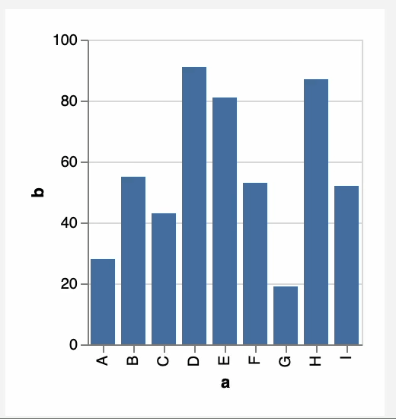
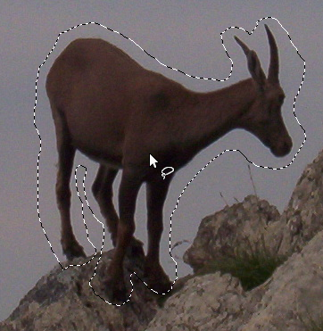
1. Select
Mark something as interesting: direct

Slide 17
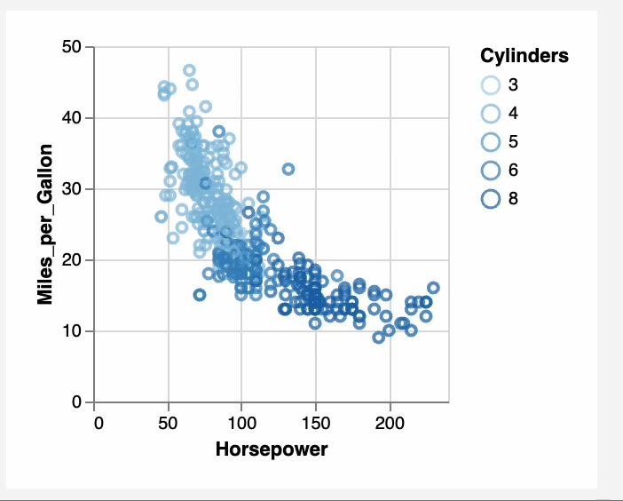
Mark something as interesting: indirect
1. Select
Notes:
Brushing

Slide 18
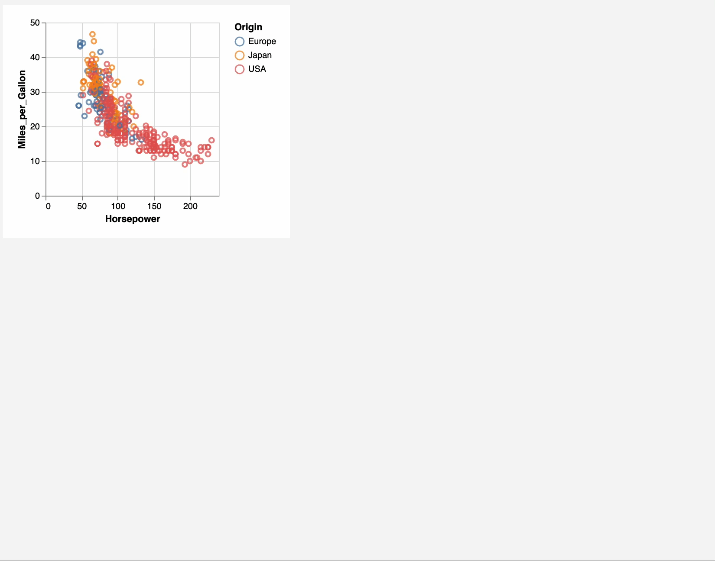
Show me something else
Scroll bars
Panning
Direct-Walk (e.g. hyperlink traversal)
2. Explore

Slide 19
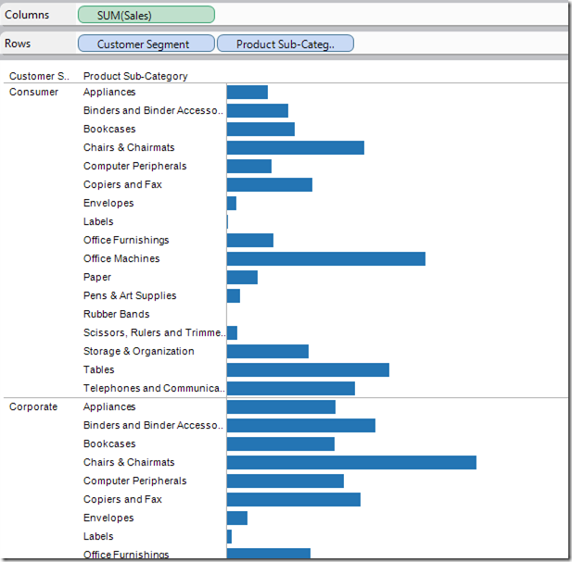
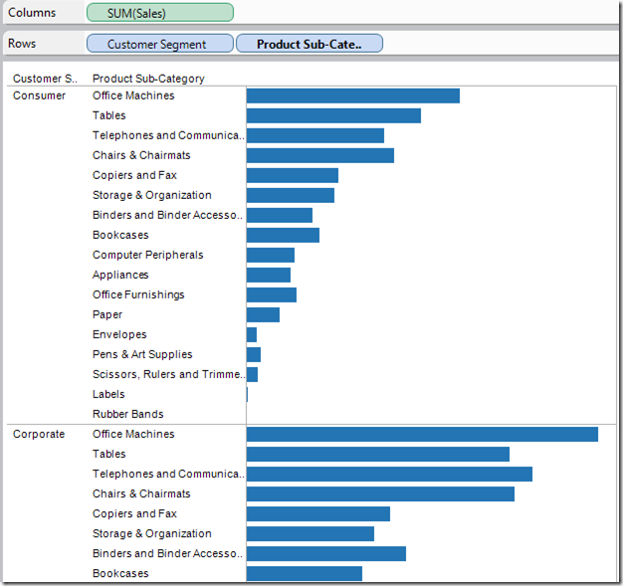
3. Reconfigure
Show me a different arrangement: sorting

Slide 20
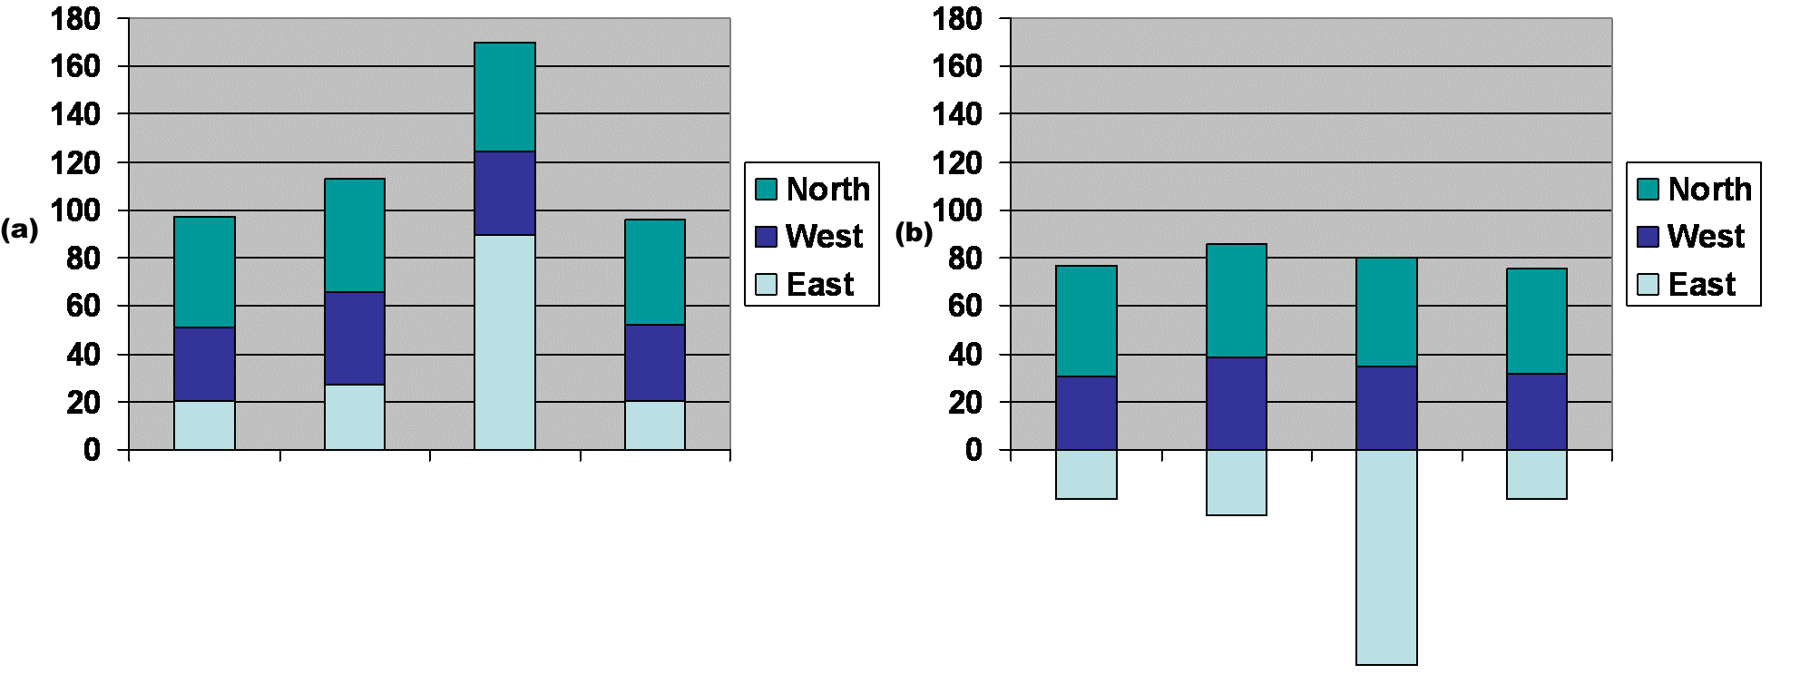
3. Reconfigure
Show me a different arrangement: baseline adjustment

Slide 21
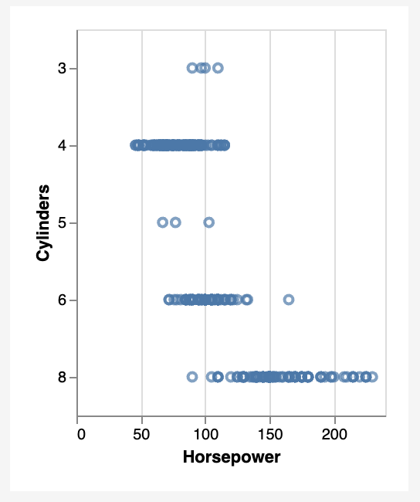
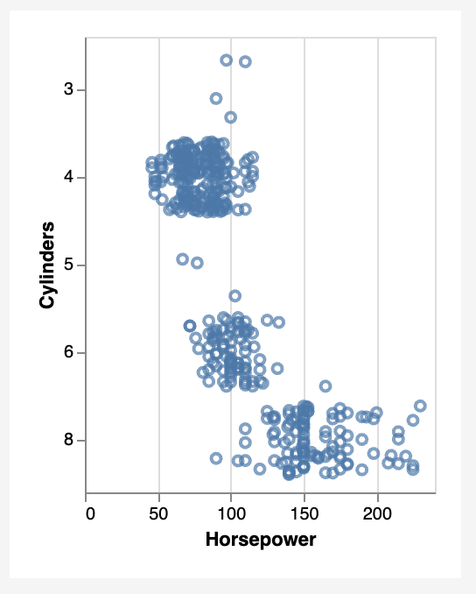
Show me a different arrangement: reduce occlusion (jitter)
3. Reconfigure

Slide 22
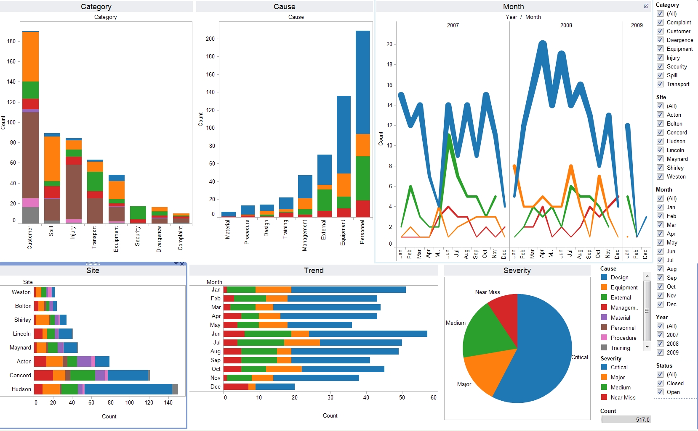
4. Encode
Show me a different representation: visualization type, color, size, orientation, etc.

Slide 23
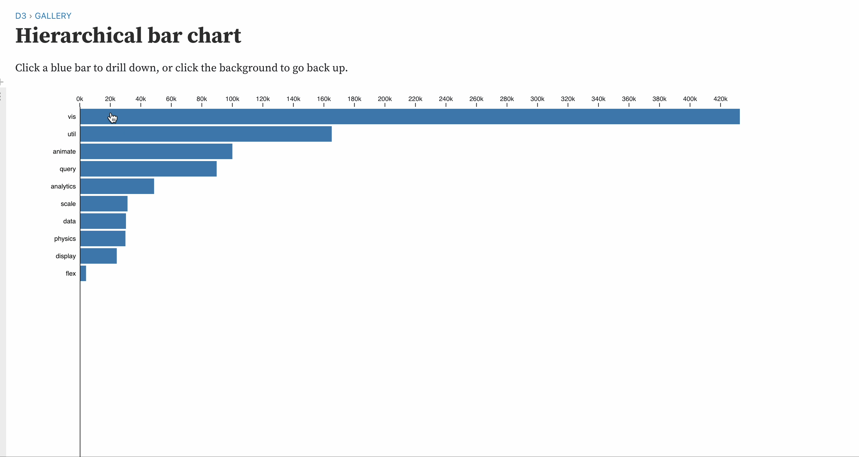
5. Abstract / Elaborate
Show me more or less detail: drill up/down

Slide 24
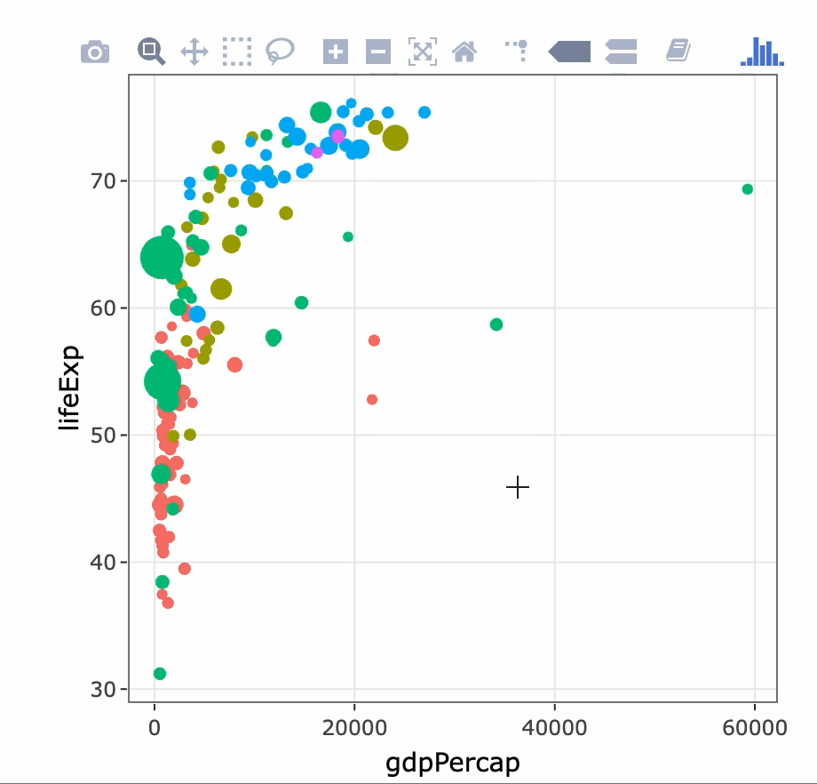
5. Abstract / Elaborate
Show me more or less detail: zooming

Slide 25
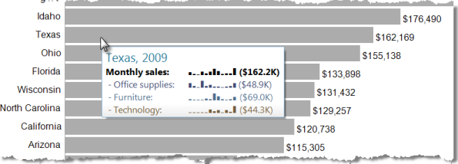
5. Abstract / Elaborate
Show me more or less detail: tooltips

Slide 26
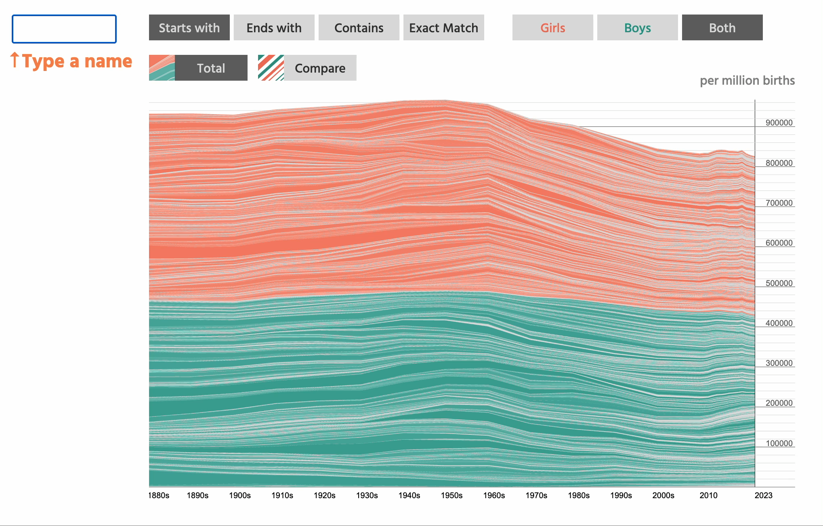
Show me something conditionally
6. Filter

Slide 27
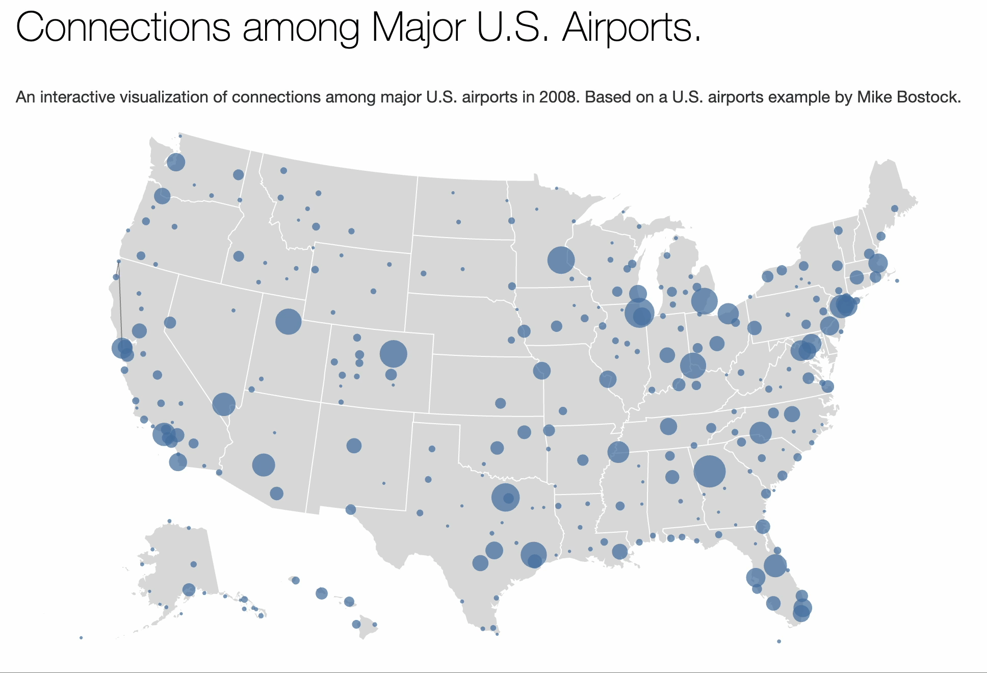
7. Connect
Show me related items: build-out

Slide 28
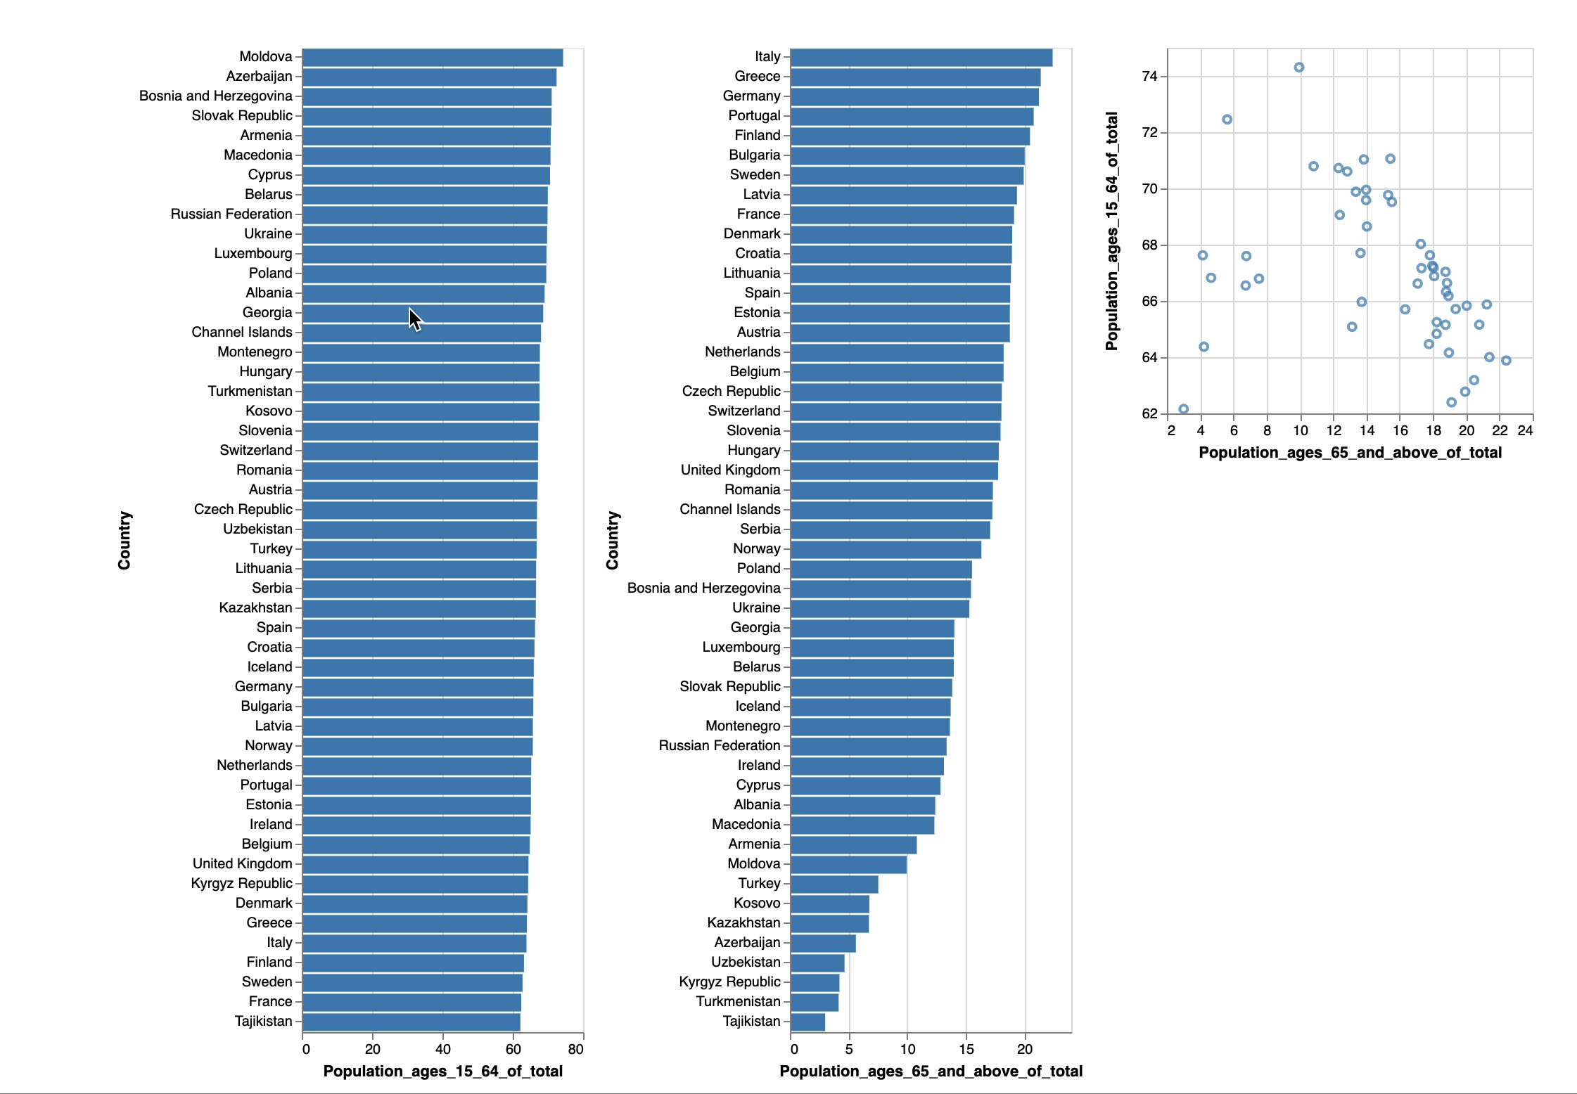
Show me related items: coordinated multiple views (CMV)
7. Connect

Slide 29
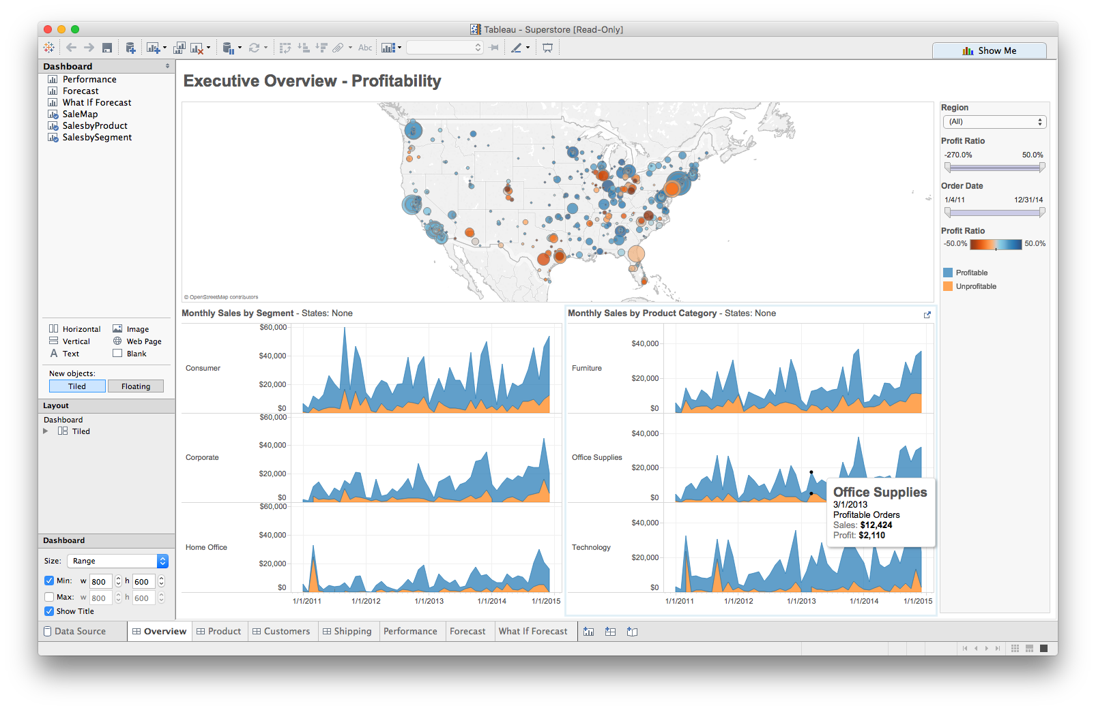
Multiple views
Different
representations
Different
data
Systems that use two or more distinct views
to support the exploration of a single concept or domain

Slide 30
Suggested questions to ask when designing
What is the goal of the analysis?
Decision-making
Better understand a domain or a problem
Identify the trends of a phenomenon
Forecast the future
…etc.
What kinds of operations do we need to enable?
How can the visualization support those operations?

Slide 31
Tableau CMV walkthrough
Demo: coordinated multiple views

